Slide 1
Employee Data Analysis Using Excel
Name : S.Selva Kumar
Register: user Id- asunm110312201281
Department : III B. Com (General)-'A’
College : DRBCCC Hindu College, Pattabiram

Slide 2
Employee Type Analysis Using Excel &
Employee Department Count Analysis Using Excel
Project Title

Slide 3

Problem Statement
Project Overview
End Users
Our Solution & Preposition
Dataset Description
Modelling Approach
Results & Discussion
Conclusion
Agenda

Slide 4
Objective:The goal of this project is to analyze and visualize the distribution of employee performance levels across different business units. The analysis will help identify areas of strength and those requiring improvement within the organization.
Project overview

Slide 5
The organization is facing challenges in understanding the distribution and concentration of employee performance levels across various business units. Without a clear visualization of this data, it becomes difficult to identify underperforming areas, allocate resources effectively, and implement targeted improvement strategies. The current lack of insight into performance metrics across different units hampers the organization's ability to optimize overall productivity and employee development.
Problem Statement

Slide 6
1. HR Managers
2. Department Heads
3.Executives/Senior Management
4. Performance Analysts
5. Learning & Development Teams
6. Workforce Planning Teams
End Users

Slide 7
Solution:We will develop a comprehensive performance analysis dashboard that includes visualizations, such as pie charts, to represent the distribution of employee performance levels across different business units. This solution will be built using the organization’s existing employee data and will provide actionable insights into areas requiring improvement and highlight top-performing segments.
Proposition:Our proposed solution will empower HR managers, department heads, and senior management with a clear, data-driven understanding of employee performance. By visualizing the performance levels, the organization can quickly identify trends, allocate resources effectively, and implement targeted strategies for enhancing overall productivity. This solution will ultimately drive better decision-making, foster employee development, and align performance with business goals.
Our Solution And Proposition

Slide 8
Employee Data: Includes employee ID, name, job title, business unit, supervisor, and contact information.Demographics Contains data on gender, race, marital status, date of birth, and location.Job Details
Information on job function, start date, exit date, and employee status.Performance Metrics Performance scores, performance levels (e.g., HIGH, LOW, MED, VERY HIGH), and employee ratings.Other Attributes Includes additional details such as email, location code, and job function descriptions.
Dataset Discription

Slide 9
Data Cleaning & Preprocessing Handle Missing Values Identify and address any missing or incomplete data in the dataset. Data Formatting Ensure consistency in data types (e.g., dates, categorical variables) and standardize naming conventions.
Exploratory Data Analysis (EDA) Descriptive Statistics: Calculate summary statistics to understand the distribution of key variables. Correlation Analysis: Identify relationships between performance metrics and other variables like job function, business unit, or demographics. Visualization: Use charts (e.g., pie charts, bar graphs) to visualize the distribution of performance levels across business units.
Model DevelopmMetrics Clustering (Optional) If needed, use clustering techniques (e.g., K-means) to identify natural groupings in the data based on performance and other factors. Predictive Modeling (Optional): Develop predictive models to forecast future performance based on historical data, using techniques like regression analysis or machine learning algorithms.
4. Validation & Testing Cross-Validation: Use cross-validation techniques to ensure model robustness and prevent overfitting. Accuracy MeMetrics Evaluate model performance using metrics like accuracy, precision, recall, or mean squared error (depending on the model).
Modelling Approach

Slide 10
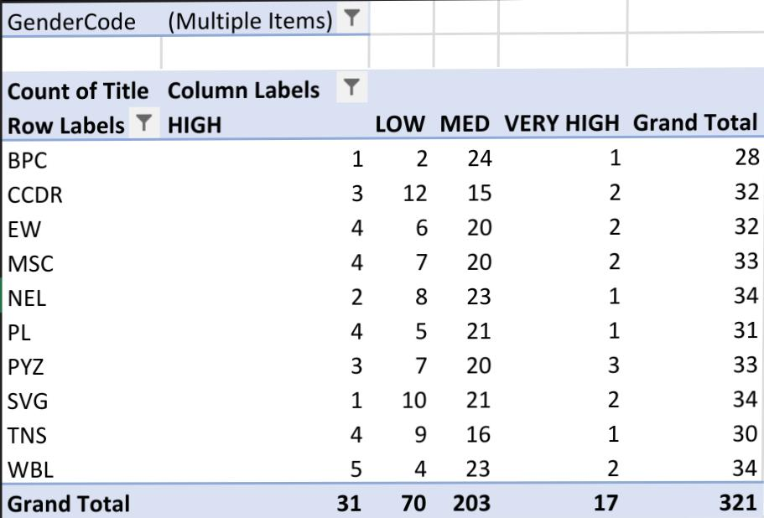
Result

Slide 11
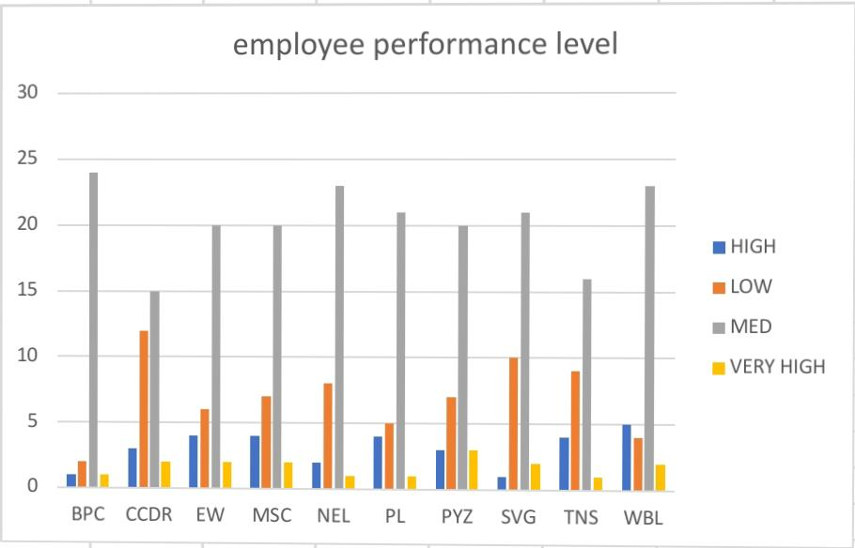
Result

Slide 12
Pie Chart: This will show the distribution of a particular category (e.g., gender, business units, or performance levels) as segments of a circle, giving a visual sense of proportion.
Table: This will present the same data in a structured format, displaying exact numbers for each category.To proceed, I need to know which specific data you want to analyze. For example, do you want to see.
The percentage of employees by gender- The breakdown of performance scores (HIGH, LOW, etc.)-The number of employees in different business units Once you specify, I can generate both the pie chart and the table for that data.
Result

Slide 13
By implementing this performance analysis solution, the organization gains a powerful tool to visualize and understand employee performance across various business units. The structured modeling approach, from data cleaning to the development of interactive dashboards, ensures that the insights generated are accurate, actionable, and aligned with organizational goals. This solution not only aids in identifying areas of excellence and concern but also empowers decision-makers to allocate resources effectively, tailor employee development programs, and drive overall business success.
Conclusion

